Slide 1
Covering Campaign Finance With Data
Sean McMinn
Github.com/shmcminn/cqrc-campfin

Slide 2
Agenda
FEC data
Lobbying data
Financial disclosure data

Slide 3
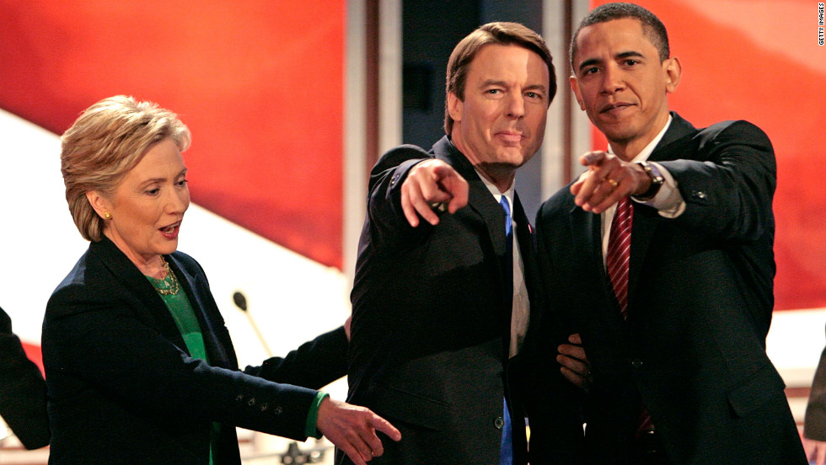
Crooks and Campaign Finance
Recognize this guy?

Slide 4
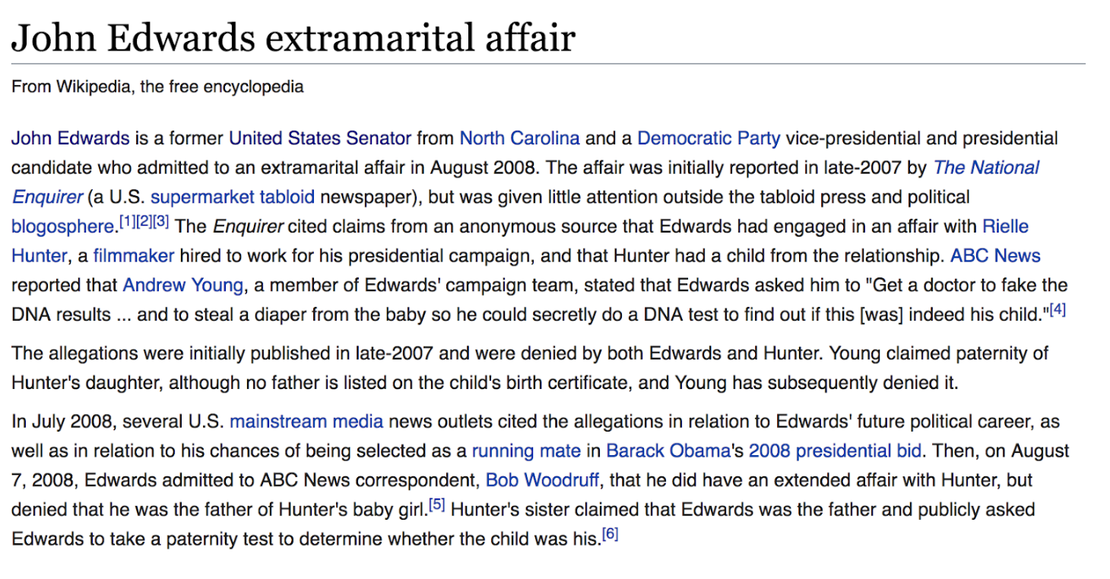
Crooks and Campaign Finance

Slide 5
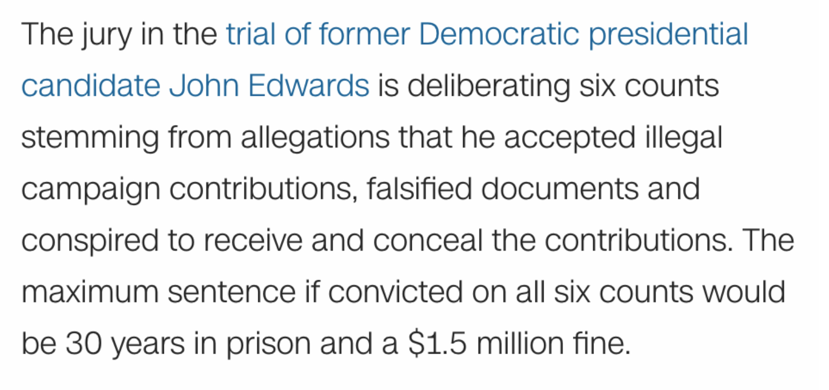
Crooks and Campaign Finance
Notes:
Rich heiress allegedly gave hundreds of thousands through the aide who claimed to be the father -- from CNN: http://www.cnn.com/2012/05/23/justice/north-carolina-edwards-charges/index.html

Slide 6
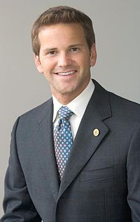
Crooks and Campaign Finance
Recognize this guy?

Slide 7
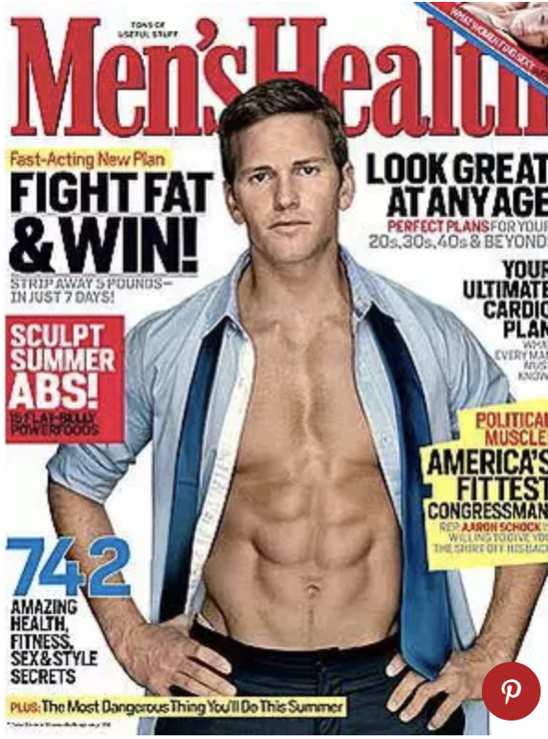
Crooks and Campaign Finance
Does this help?

Slide 8
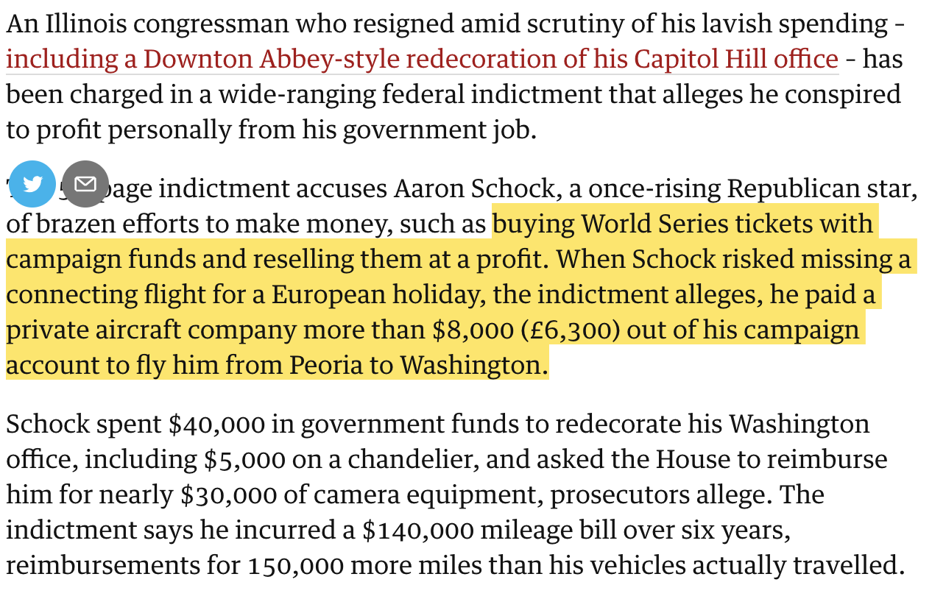
Crooks and Campaign Finance
Notes:
This was at the end of 2016 … Trial set for next January

Slide 9
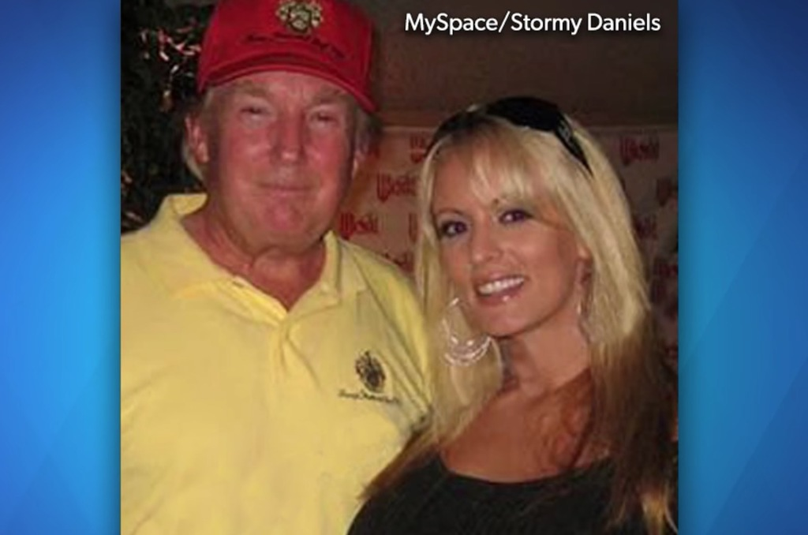
Crooks and Campaign Finance
Recognize this pair?

Slide 10
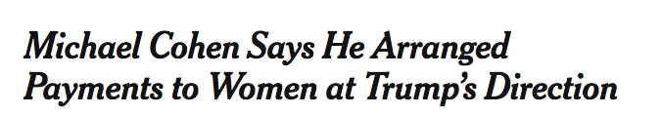
Crooks and Campaign Finance

Slide 11
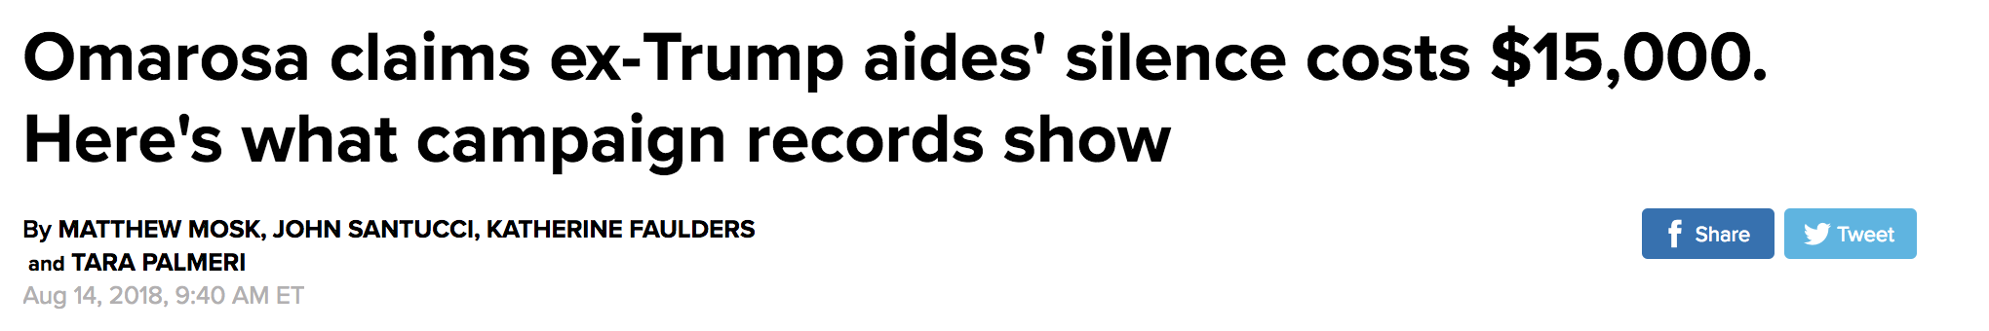

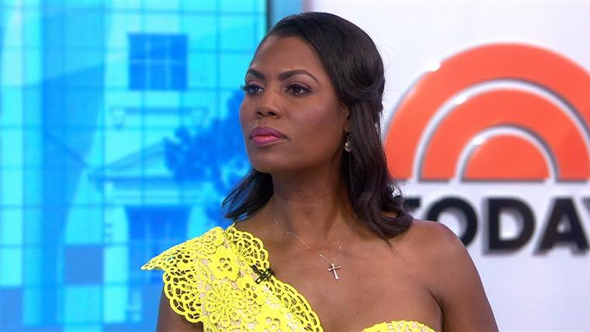
Crooks and Campaign Finance

Slide 12
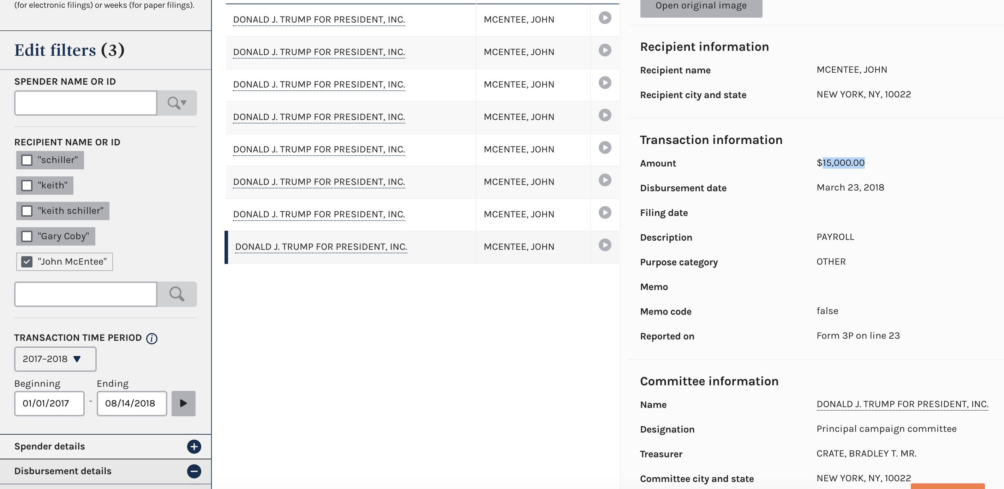
Crooks and Campaign Finance

Slide 13
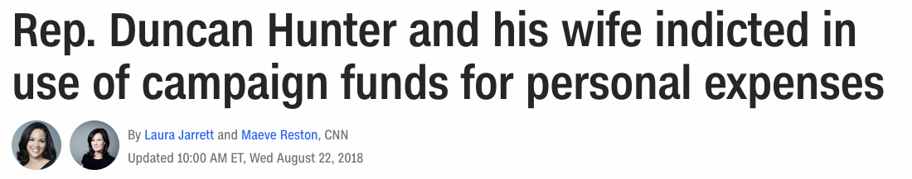
Crooks and Campaign Finance
And fresh off the presses!

Slide 14
Campaign Finance
All campaign contributions over $200 must be itemized and reported by the committee that receives them
All campaign expenditures must be itemized and reported by the committee

Slide 15
Campaign Finance
Rachel Shorey: Three general types of camp fin stories:
Horserace stories: Which candidate is winning the money race?
Donor stories: Who is giving money (and why)?
Legal analysis stories: How are candidates working creatively inside (or outside) the law?

Slide 16
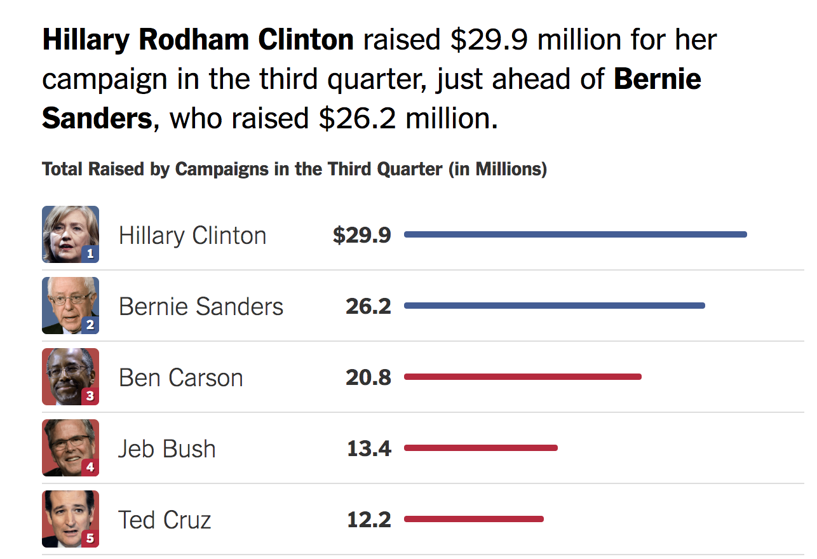
Campaign Finance

Slide 17
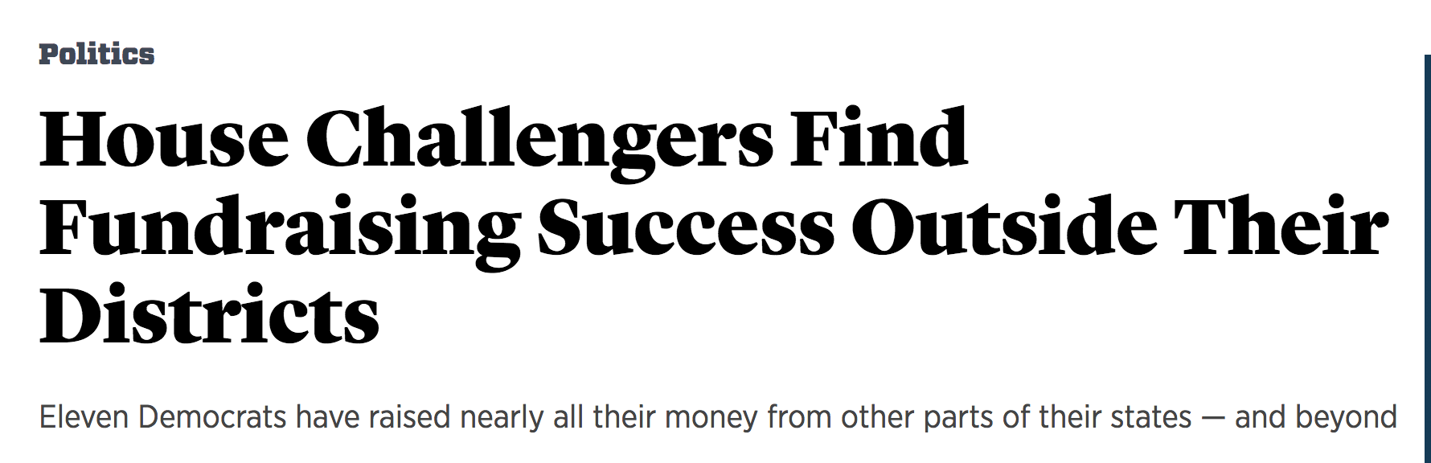
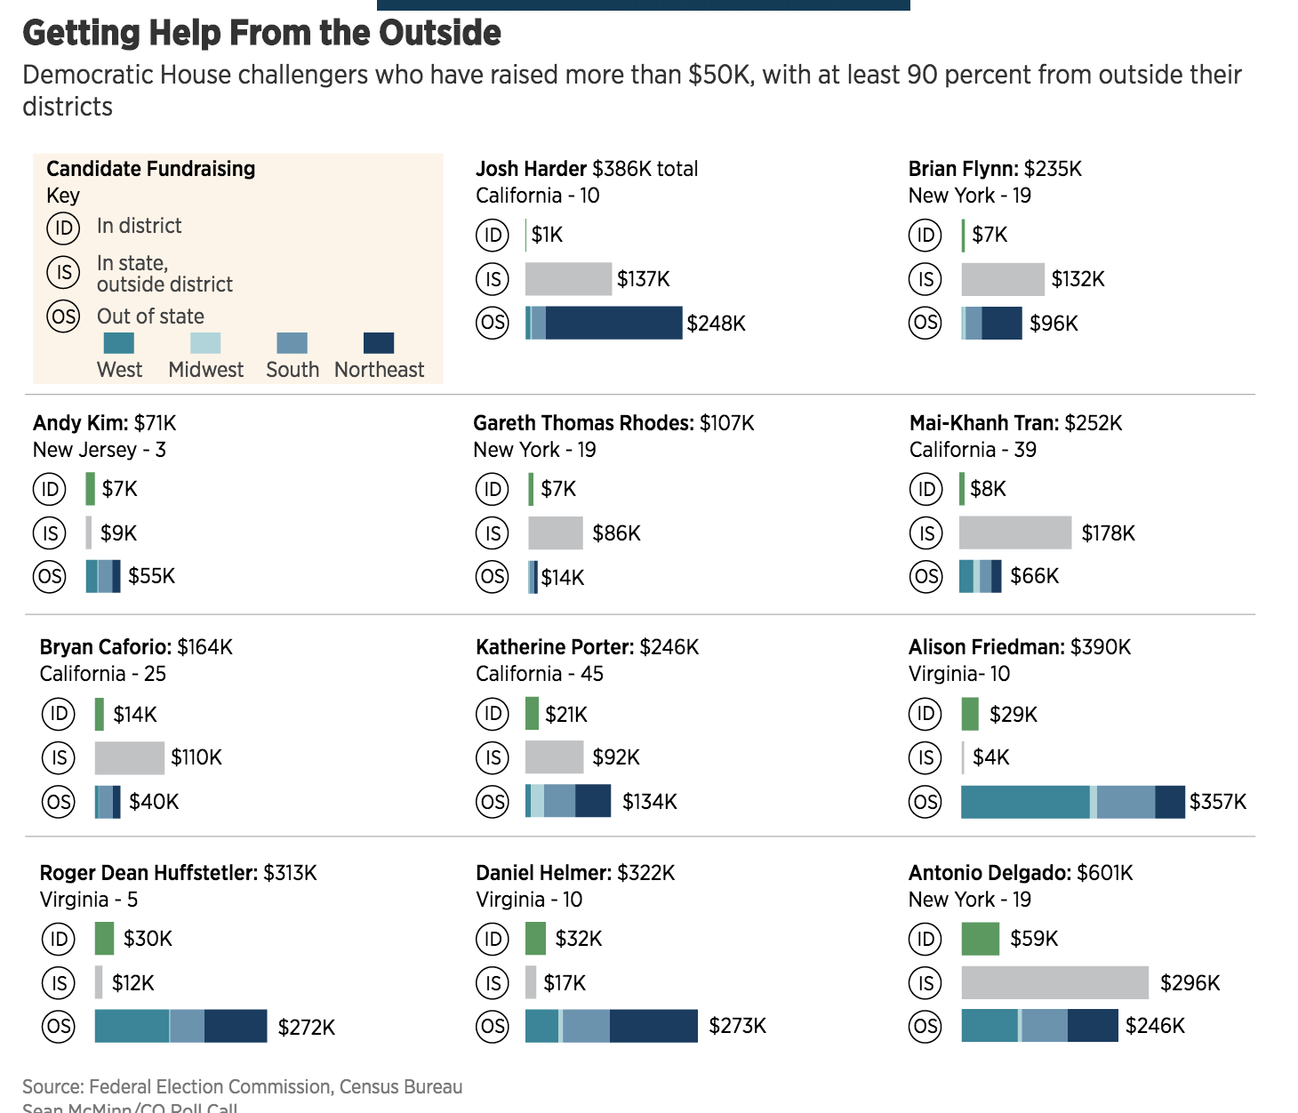
Campaign Finance

Slide 18
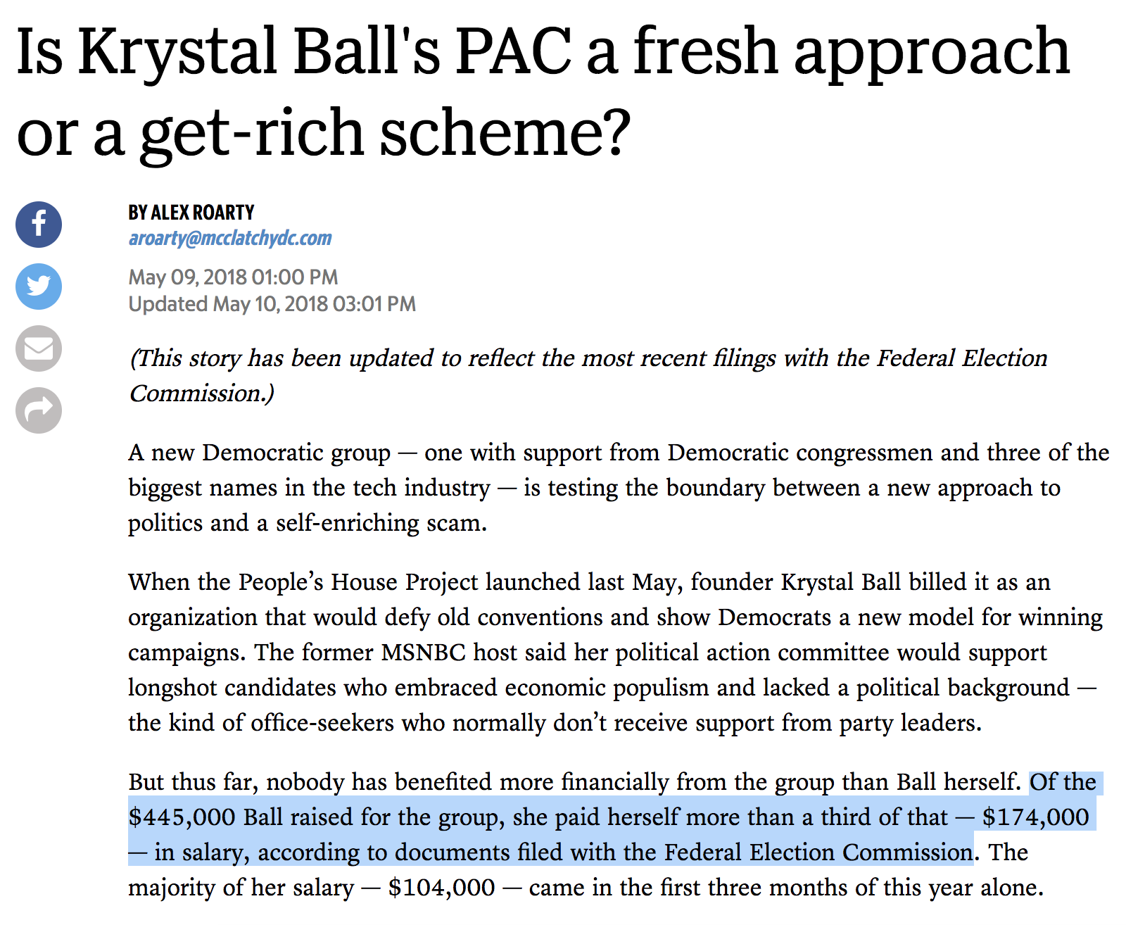
Campaign Finance

Slide 19
Campaign Finance
To touch on PACs:
Anyone can set up their own committee to help a campaign
BUT there’s limitations on how much donors can give
The answer? Super PACs

Slide 20
Campaign Finance
How can reporters find these stories?
FEC.gov – your best friend for federal campaign finance
Notes:
Look up: Spielberg, Northwestern president, Trump Northwestern donations, Clinton Northwestern donations

Slide 21
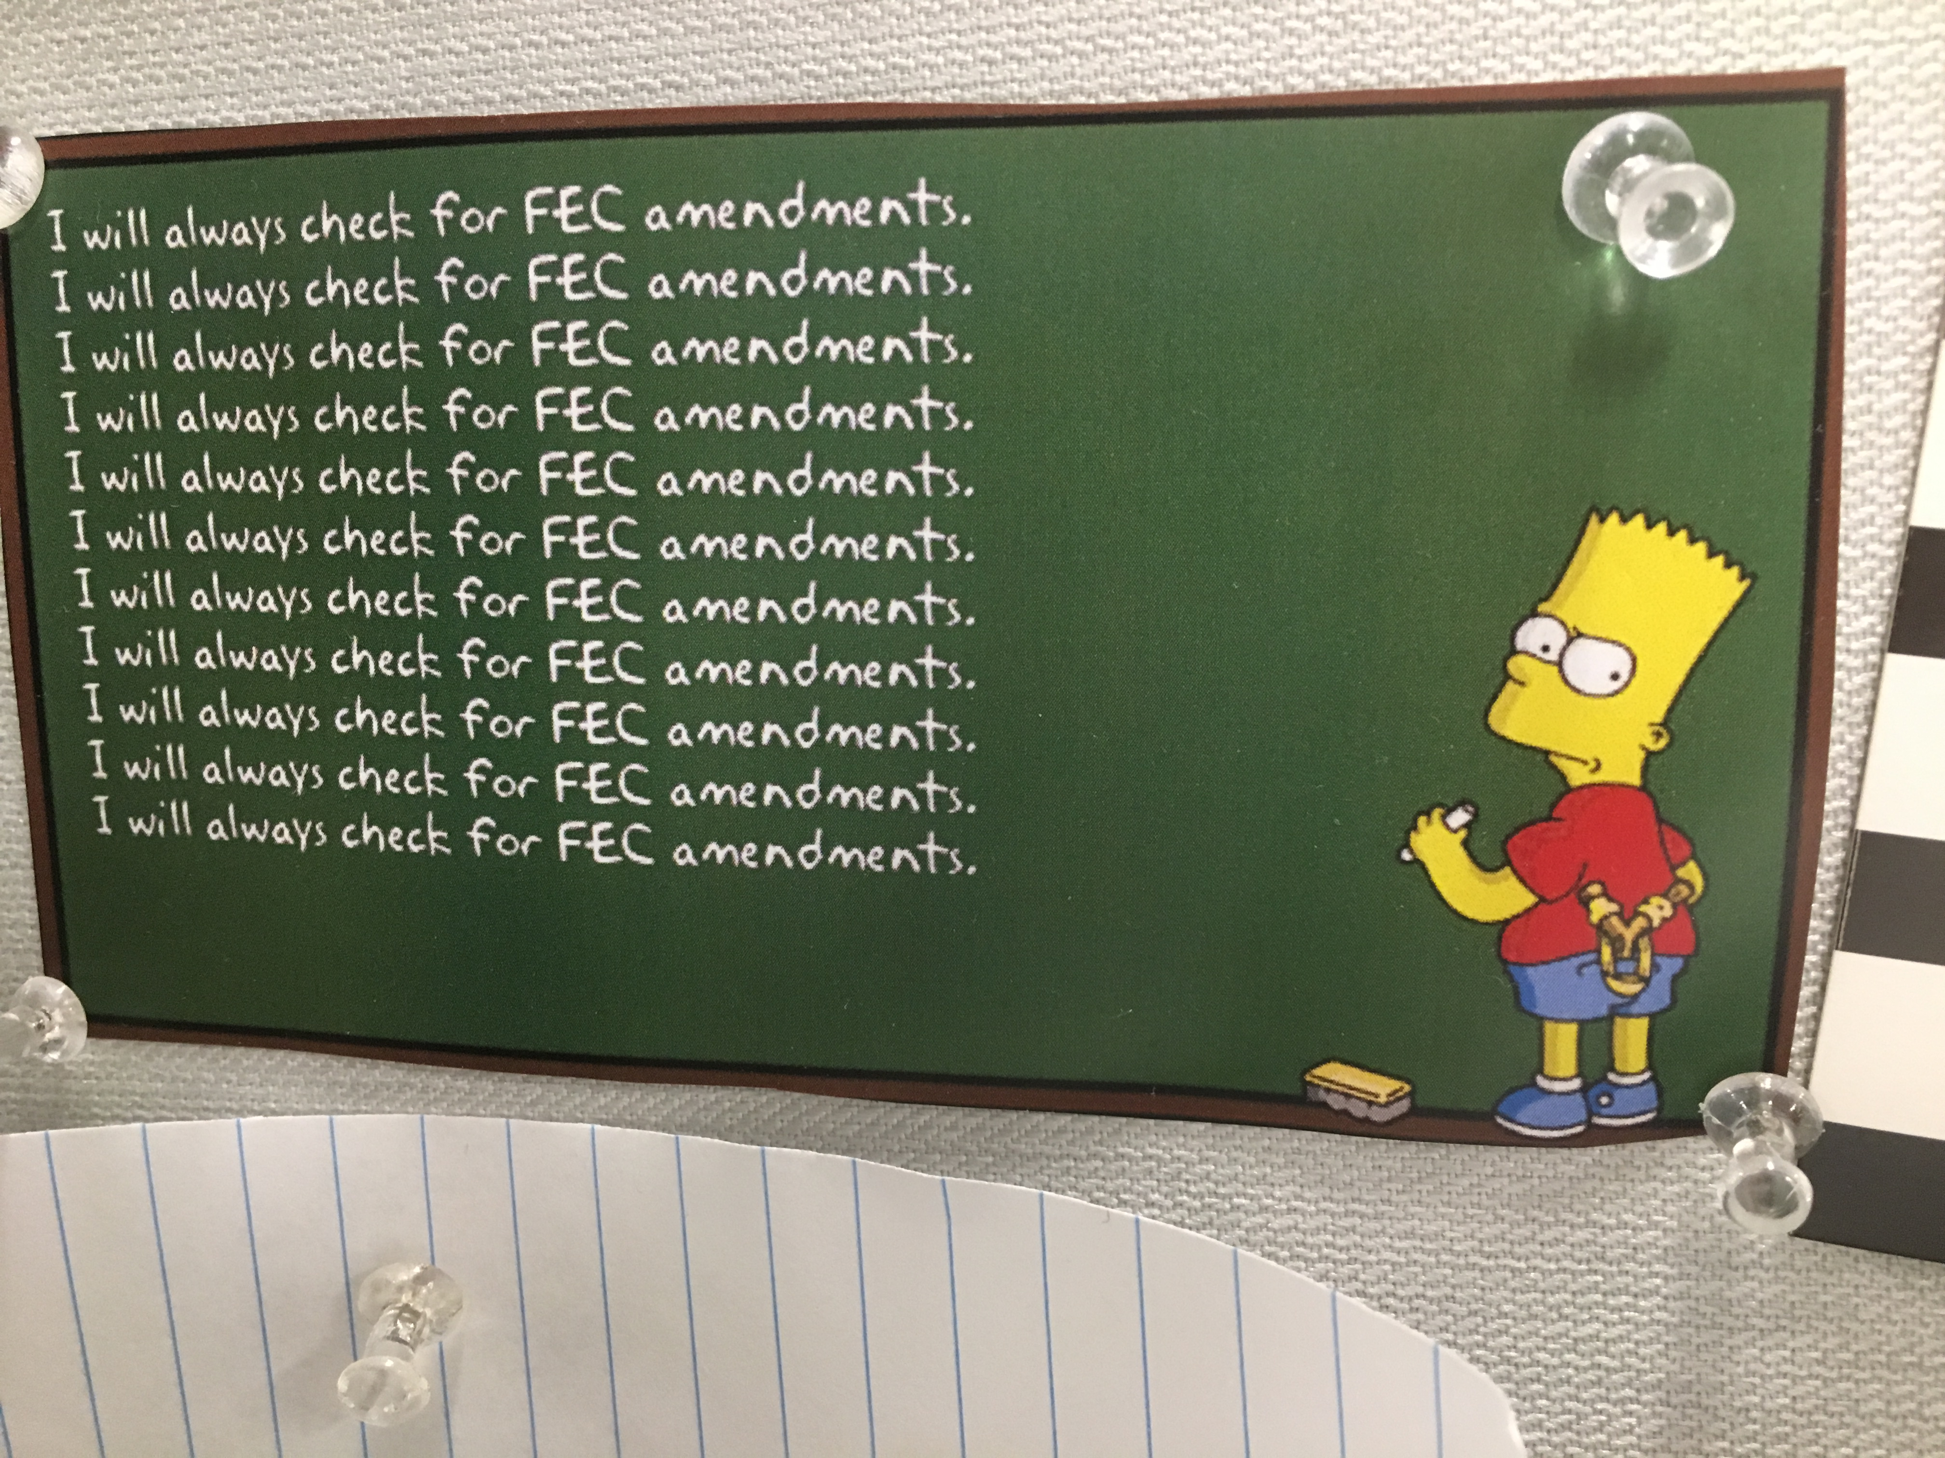
Campaign Finance
Notes:
Look up: Spielberg, Northwestern president, Trump Northwestern donations, Clinton Northwestern donations

Slide 22
Campaign Finance
Pitfalls
Amendments
Refunds
$200 caveat – small vs big donors
Generally good to check your analysis by someone who’s done this before

Slide 23
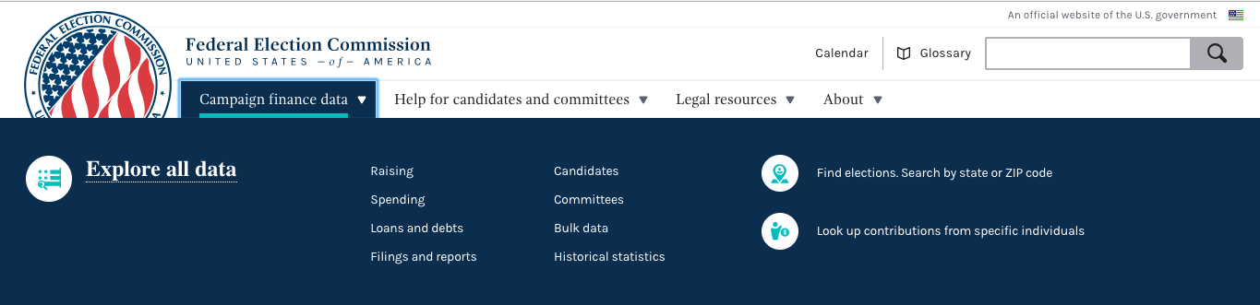
FEC.gov

Slide 24
Campaign Finance
Most useful pages on FEC website
Report summaries
Itemized contributions
Itemized disbursements
Notes:
Look up: Cruz v O’Rourke totals
itemized contributions search for george soros
Trump spending at Amazon

Slide 25
Other Resources
Open Secrets (CRP) (categorized and tagged data by industry, etc)
Opensecrets.org
Propublica FEC Itemizer (easy to search)https://projects.propublica.org/itemizer/

